Slide 1
College | Annual kWh | Total billed Amount | $/kWh
UH Manoa | 116,131,200 | $ 22,670,154.00 | $ 0.195
Kapiolani CC | 6,234,210 | $ 736,093.00 | $ 0.118
Leeward CC | 5,409,367 | $ 1,372,745.00 | $ 0.254
Honolulu CC | 4,815,548 | $ 684,232.00 | $ 0.142
Windward CC | 4,798,650 | $ 1,087,345.00 | $ 0.227
Maui College | 4,852,439 | $ 1,235,181.00 | $ 0.255
UH Hilo | 13,156,401 |  | $
UH West Oahu | 3,179,509 |  | $ -
Hawaii CC | 2,387,793 | $ 684,232.00 | $ 0.287
Total | 160,965,117 | $ 28,469,982.00 | $ 1.477
Notes: Data for total bills still unknown for UH Hilo and UH West Oahu

Slide 2
College | Annual kWh | Gross Sq. Ft. | EUI
UH Manoa | 116,131,200 | 7,744,860 | 14.99
Kapiolani CC | 6,234,210 | 406,569 | 15.33
Leeward CC | 5,409,367 | 450,679 | 12.00
Honolulu CC | 4,815,548 | 744,502 | 6.47
Windward CC | 4,798,650 | 370,708 | 12.94
Maui College | 4,852,439 | 415,734 | 11.67
UH Hilo | 13,156,401 | 843,606 | 15.60
UH West Oahu | 3,179,509 | 221,839 | 14.33
Hawaii CC | 2,387,793 | 232,601 | 10.27
Notes: UH Hilo has the Highest Overall Energy Use Index (EUI) of all UH campuses.

Slide 3
Hawaii Energy (2015 Analysis) to 2018 UH Analysis
HE 2015
UH 2018
College | Annual kWh ( | Gross Sq. Ft. | EUI
UH Manoa | 111,852,995 | 5,181,925 | 21.6
Kapiolani CC | 6,272,760 | 406,569 | 15.4
Leeward CC | 5,048,199 | 450,679 | 11.2
Honolulu CC | 4,451,034 | 744,502 | 6.0
Windward CC | 4,405,800 | 370,708 | 11.9
UH Maui College | 4,142,629 | 415,734 | 10.0
UH Hilo | 2,614,408 | 843,606 | 3.1
UH West Oahu | 388,880 | 221,839 | 1.8
Hawaii CC | 152,002 | 232,601 | 0.7
College | Annual kWh | Gross Sq. Ft. | EUI
UH Manoa | 116,131,200 | 7,744,860 | 14.99
Kapiolani CC | 6,234,210 | 406,569 | 15.33
Leeward CC | 5,409,367 | 450,679 | 12.00
Honolulu CC | 4,815,548 | 744,502 | 6.47
Windward CC | 4,798,650 | 370,708 | 12.94
Maui College | 4,852,439 | 415,734 | 11.67
UH Hilo | 13,156,401 | 843,606 | 15.60
UH West Oahu | 3,179,509 | 221,839 | 14.33
Hawaii CC | 2,387,793 | 232,601 | 10.27
Notes: -UH Hilo in the HE Table was inaccurate, Annual kWh should’ve been in the 11-13,000,000 range -UH West O’ahu and Hawaii CC increased dramatically due to more buildings and usage since the last analysis

Slide 4
Building | kWh/yr (2015) | kWh/yr (2018) | EUI (2015) | EUI (2018)
POST | 7,051,520 | 9,279,014 | 46 | 37.61
Hamilton Library | 14,576,034 | 8,064,872 | 38 | 76.97
Bilger Hall | 6,675,992 | 7,800,650 | 45 | 91.98
Biomedical Science | 7,557,511 | 7,077,494 | 41 | 36.28
ITS | N/A | 4,394,850 | N/A | 59.4
Stan Sheriff Center | ~6,700,000 | 4,812,269 | 36 | 25.32
Notes: -POST, Hamilton, and Bilger EUI went up significantly due to higher demand -Biomed and Stan Sheriff decreased due to less demand -ITS building was not operational during HE analysis

Slide 5
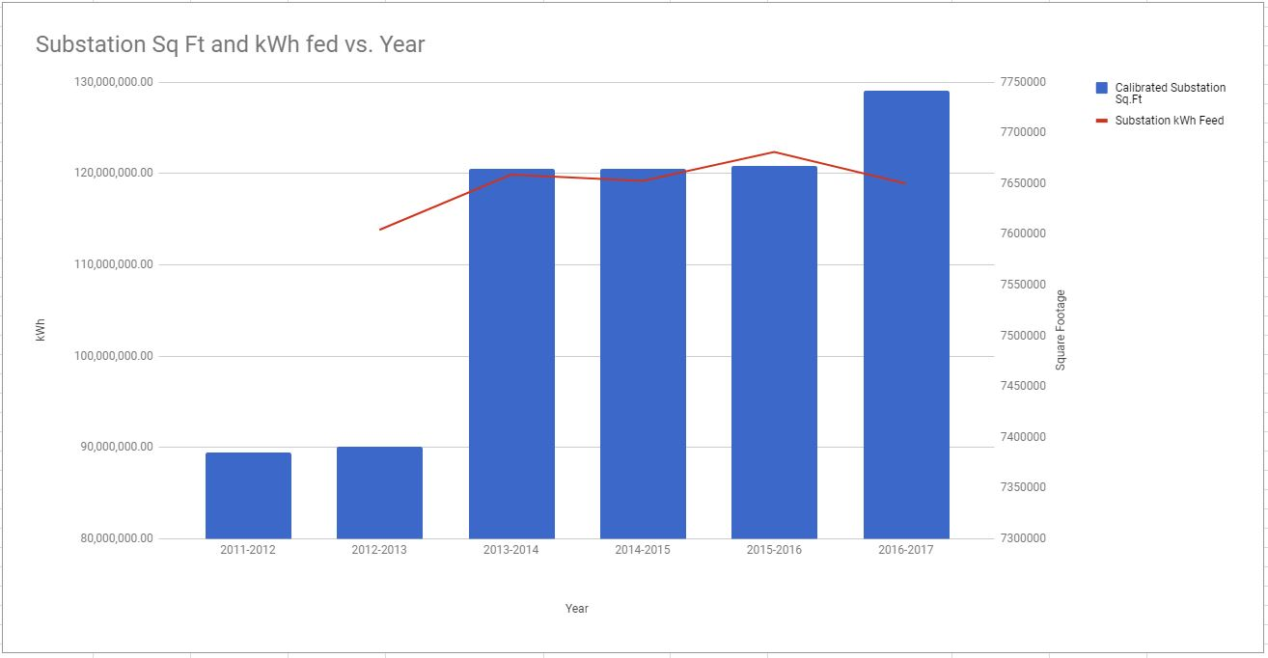
Annual EUI Comparison

Slide 6
Annual EUI Comparison UH Manoa
Fiscal Year | Calibrated Substation Sq.Ft | Substation kWh Feed | EUI
2011-2012 | 7,384,733.7 |  | 0
2012-2013 | 7,391,227.7 | 113,820,000.00 | 15.39933622
2013-2014 | 7,664,404.7 | 119,871,896 | 15.64007916
2014-2015 | 7,664,404.7 | 119,193,897.30 | 15.55161841
2015-2016 | 7,667,474.7 | 122,347,845.13 | 15.9567328
2016-2017 | 7,741,939.9 | 118,899,869 | 15.35789108
Note: Calibrated Substation only takes into account buildings on main UH Manoa campus, doesn’t include payroll buildings like Lab School, IFA, etc.

